Slide 1
Auto Scaling – EC2

Slide 2
Exercises
Keep this group at its initial size
Use scaling policies to adjust the capacity of this group

Slide 3
Pre-requisites
Login to AWS account
Region(e.g. N. Virginia)
Security Group is set for all traffic

Slide 4
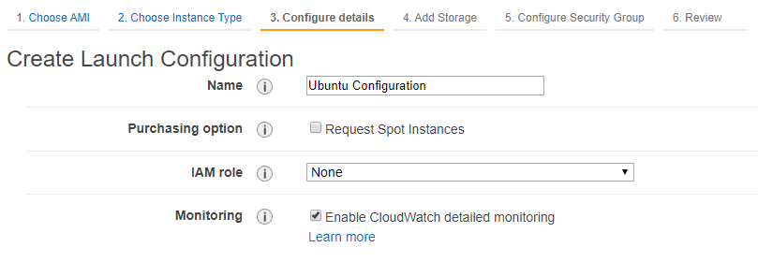
Create Launch Configuration
Go to Launch Configurations section under AUTO SCALING in left pane
Click Create launch configuration
Follow the wizard to create new configuration(like instance)
Note: Enter Configuration Name & Enable CloudWatch detailed monitoring on Configure details page

Slide 5
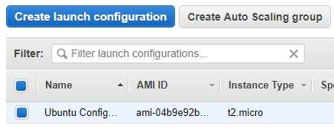
Create Launch Configuration
Close configuration creation window
Configuration will be displayed in list

Slide 6
Keep this group at its initial size

Slide 7
Create Auto Scaling Group
Go to Launch Configurations section under AUTO SCALING in left pane
Click Create Auto Scaling group
Enter Group name
Keep Group size – 1 instance
Select the Subnet(e.g. us-east-1a)
Click Next: Configure scaling policies

Slide 8
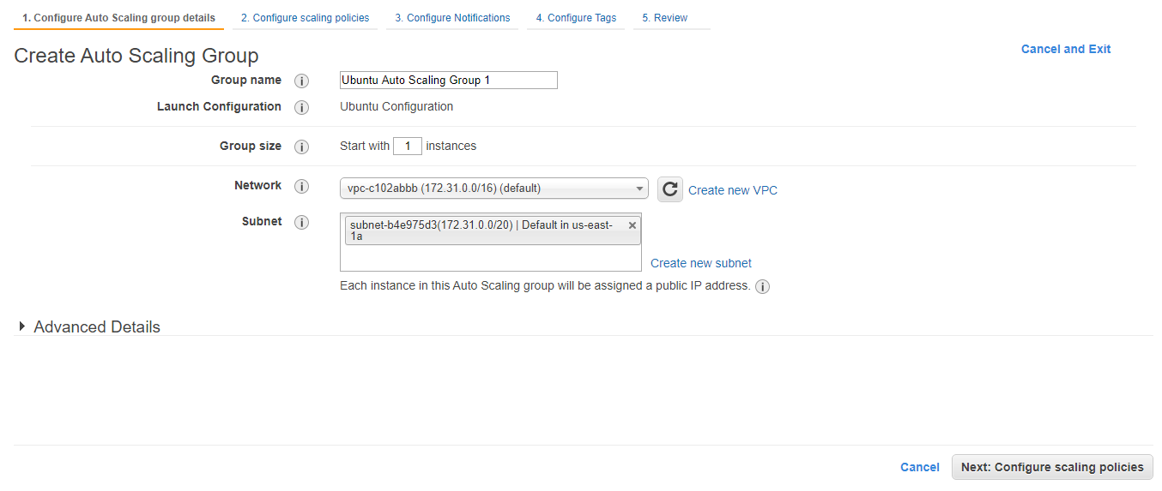
Create Auto Scaling Group

Slide 9
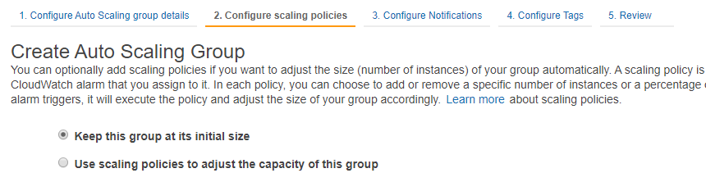
Create Auto Scaling Group
Select Keep this group at its initial size radio button
Click Next: Configure Notifications

Slide 10
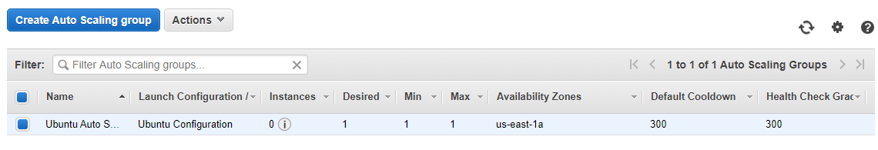
Create Auto Scaling Group
Click Next: Configure Tags
Click Review
Click Create Auto Scaling group
Close Auto Scaling group creation window
Auto Scaling Group will be displayed in list
Note: (You can go to EC2 dashboard & see 1 new instance will be created) (this may take several minutes in free tier)

Slide 11
Edit Auto Scaling Group
Select Auto Scaling group
Click Actions
Click Edit
Edit Health check grace period from 300 to 30 sec
Edit Default Cool down from 300 to 30 sec
Desired Capacity --> 1
Min --> 1
Max --> 3
Click Save

Slide 12
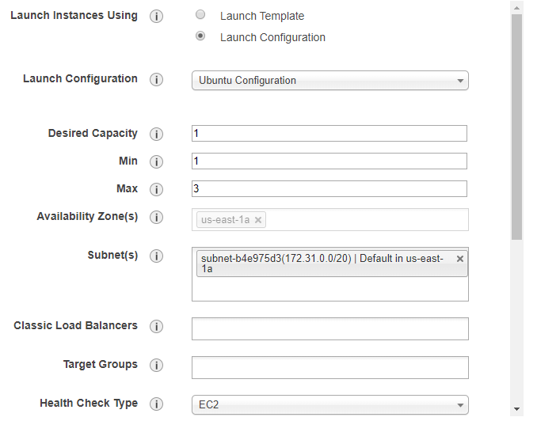
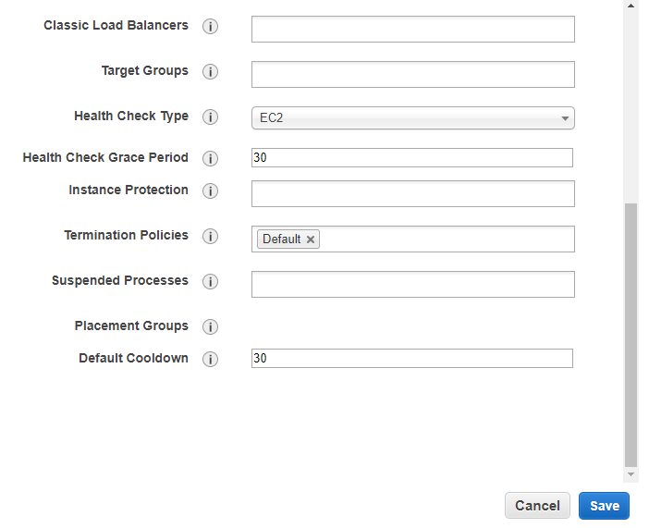
Edit Auto Scaling Group

Slide 13
Auto Scaling
Go to EC2 dashboard
Stop/Terminate the instance
Refresh the page after few seconds
New instance will be created by it's own

Slide 14
Use scaling policies to adjust the capacity of this group

Slide 15
Create Auto Scaling Group
Go to Launch Configurations section under AUTO SCALING in left pane
Click Create Auto Scaling group
Enter Group name
Keep Group size – 1 instance
Select the Subnet(e.g. us-east-1a)
Click Next: Configure scaling policies

Slide 16
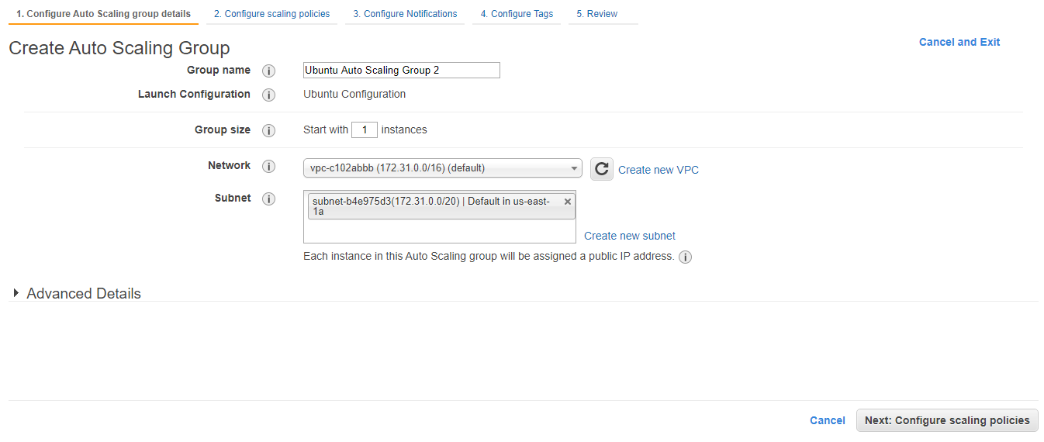
Create Auto Scaling Group

Slide 17
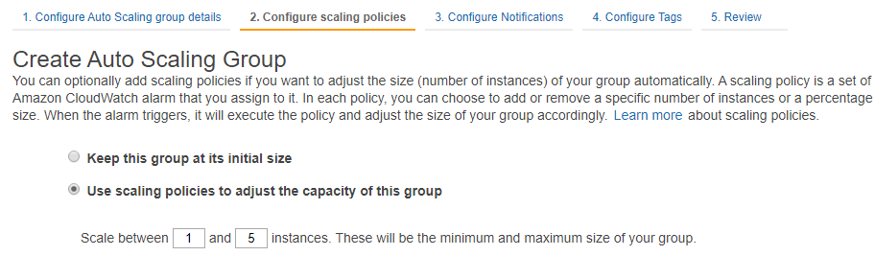
Create Auto Scaling Group
Select Use scaling policies to adjust the capacity of this group radio button
Scale between 1 and 5 instances
Click Scale the Auto Scaling group using step or simple scaling policies link

Slide 18
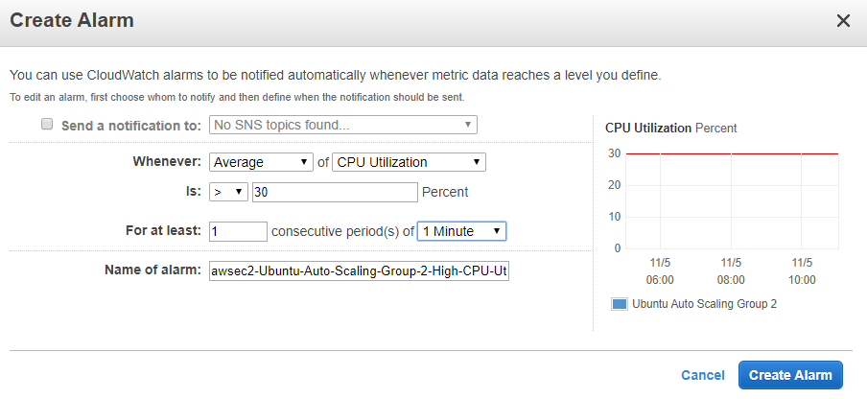
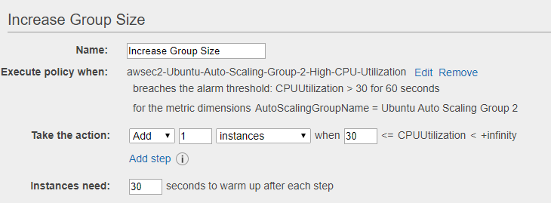
Increase Group Size
Click Add new alarm
Deselect Send a notification to checkbox
Average of CPU Utilization is > 30
For atleast of 1 of 1 Minute
Click Create Alarm
Add 1 instance
Instances need: 30 Sec

Slide 19
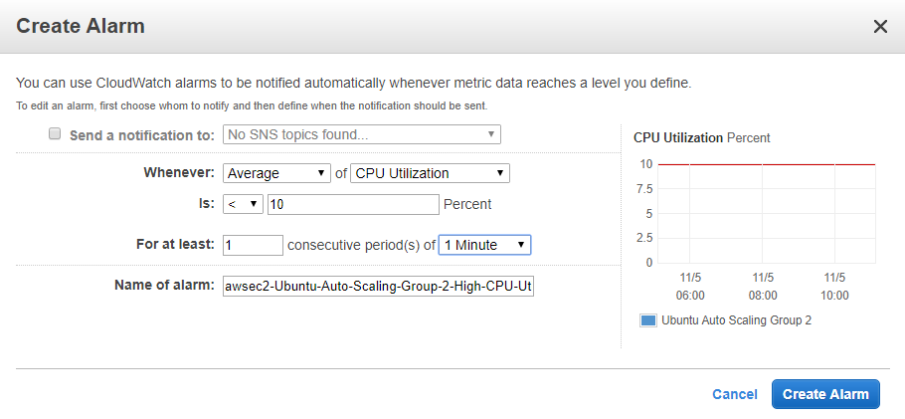
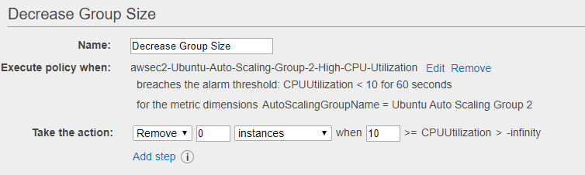
Decrease Group Size
Click Add new alarm
Deselect Send a notification to checkbox
Average of CPU Utilization is < 10
For atleast of 1 of 1 Minute
Click Create Alarm
Remove 1 instance
Instances need: 30 Sec

Slide 20
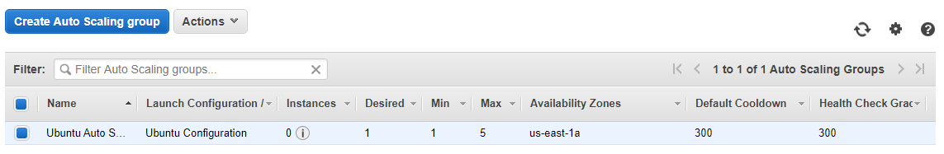
Create Auto Scaling Group
Click Next: Configure Notifications
Click Next: Configure Tags
Click Review
Click Create Auto Scaling group
Close Auto Scaling group creation window
Auto Scaling Group will be displayed in list
Note: (You can go to EC2 dashboard & see 1 new instance will be created)

Slide 21
Edit Auto Scaling Group
Select Auto Scaling group
Click Actions
Click Edit
Edit Health check grace period from 300 to 30 sec
Edit Default Cool down from 300 to 30 sec
Click Save

Slide 22
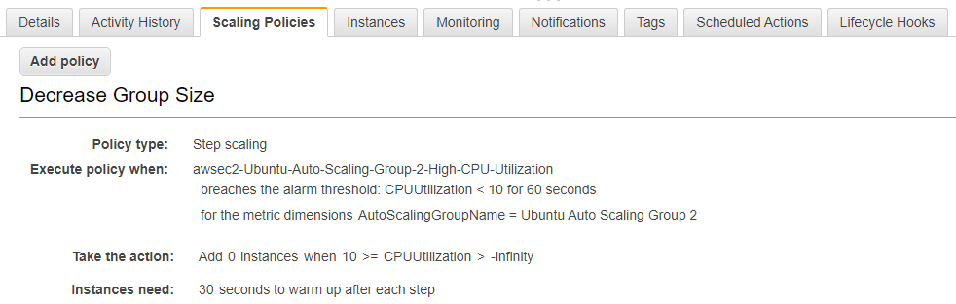
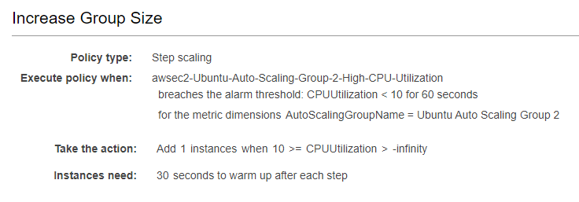
Verify Scaling Policy
Go to Auto Scaling Groups section
Click Scaling Policies tab at bottom of page
Scaling policies will be displayed

Slide 23
Increase CPU consumption on instance
Access to instance using putty
run below commands:
sudo snap install stress-ng
uptime
sudo stress-ng --cpu 8 -v --timeout 90s
See cpu status in another putty session by running below commad:
htop

Slide 24
Increase CPU consumption on instance
Go to AWS UI
Go to EC2 dashboard
New instances will be created by it's own as high cpu consumption
After 90sec when all load will down, created instances will be terminated by it's own as low cpu consumption

